Slide 1
Visualizing the Supply Chain
Bay Area R Users’ Group
2011.12.13
Anthony Sabbadini
sabbadini@economicriskmanagement.com

Slide 2
Outline
1. Flow Charts
2. Transportation Maps
3. Mashups

Slide 3
1. Flow Charts

Slide 4
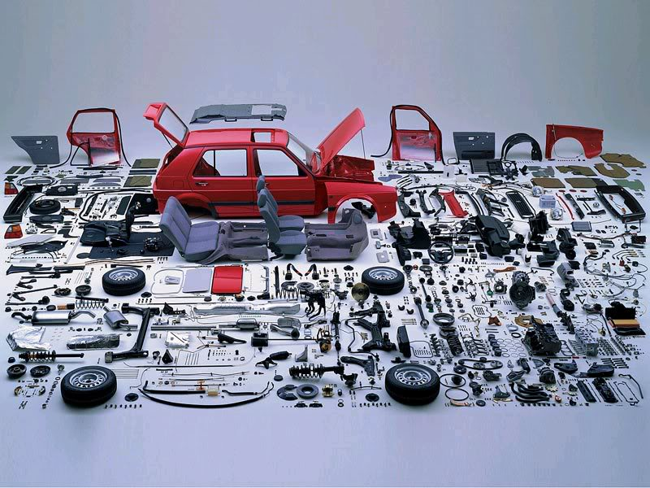
Keeping Track of Parts is Important

Slide 5
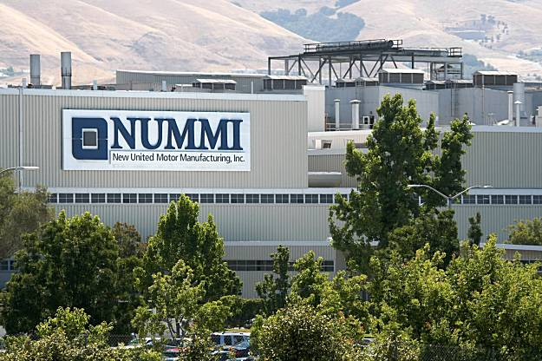
This was especially important where I used to Work

Slide 6
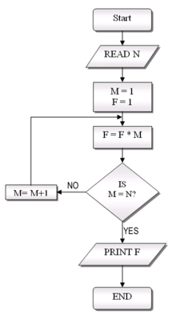
Flow Charts can Help

Slide 7
Flow Charts with ‘diagram’
library(diagram)
names <- c("Chicago", "Detroit", "Fremont", "LA", "Memphis", "San Antonio", "Tijuana")
M <- matrix(nrow = 7, ncol = 7, byrow = TRUE, data = c(
# ch de fr la me sa ti
0, 1, 0, 0, 0, 0, 0, #ch
0, 0, 0, 0, 0, 0, 0, #de
1, 0, 0, 1, 1, 1, 1, #fr
1, 0, 0, 0, 1, 0, 0, #la
0, 0, 0, 0, 0, 0, 0, #me
0, 0, 0, 0, 0, 0, 0, #sa
0, 0, 1, 1, 0, 1, 0 #ti
))
png(’nummi.png')
pp <- plotmat(M, pos = c(1,3,2,1), curve = 0.1, name = names,
lwd = 1, box.lwd = 2, cex.txt = 0.8,
box.type = "square", box.prop = 0.5, arr.type = "triangle",
arr.pos = 0.4, shadow.size = 0.00, prefix = "f",
main = "NUMMI network")
dev.off()

Slide 8
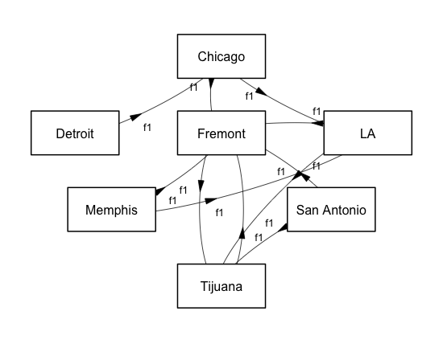
NUMMI factory network

Slide 9
2. Transportation Maps

Slide 10
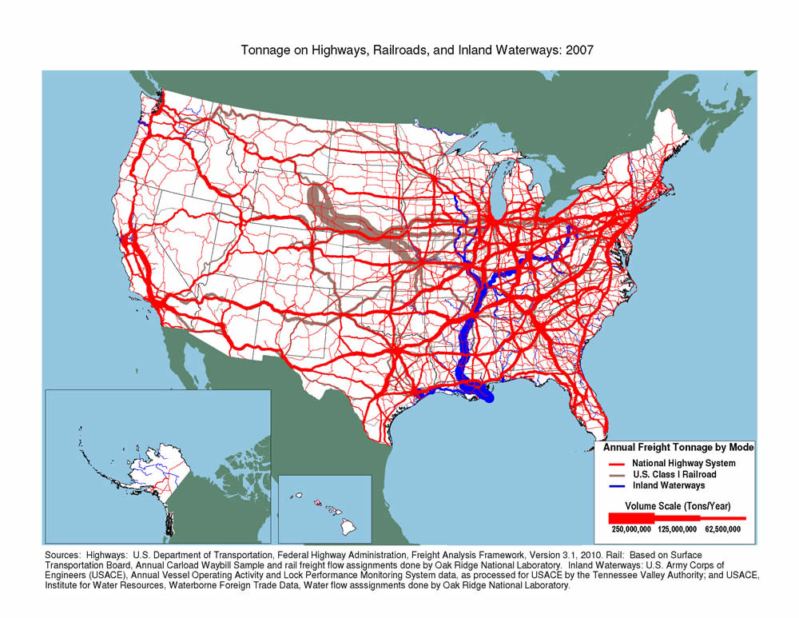

Slide 11
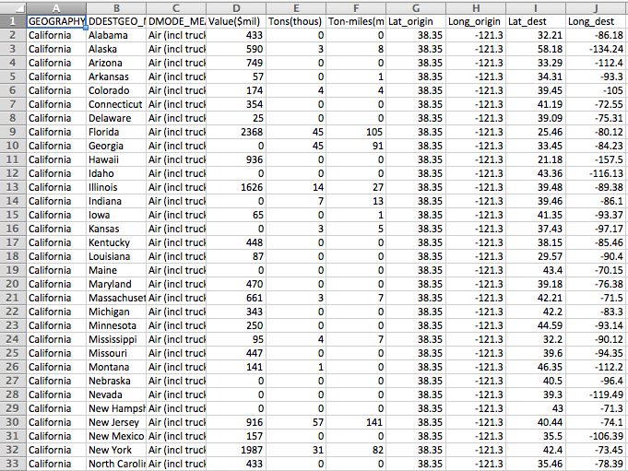
Interstate Commerce
Shipments from California (2007)
source: http://ops.fhwa.dot.gov/freight/freight_analysis/faf/index.htm

Slide 12
Spoke Networks with ‘geosphere’
library(maps)
library(geosphere)
# Unique transportation modes
modes <- unique(california$DMODE_MEANING)
# Color
pal <- colorRampPalette(c("#333333", "white", "#1292db"))
colors <- pal(100)
# Cycle through the transportation modes
for (i in 1:length(modes)) {
pdf(paste("value_mode", modes[i], ".pdf", sep=""), width=11, height=7)
map("world", col="#191919", fill=TRUE, bg="#000000", lwd=0.05, xlim=xlim, ylim=ylim)
csub <- california[california$DMODE_MEANING == modes[i],]
csub <- csub[order(csub$Value..mil.),]
maxcnt <- max(csub$Value..mil.)
for (j in 1:length(csub$GEOGRAPHY)) {
arc <- csub[j,]
inter <- gcIntermediate(c(arc[1,]$Long_origin, arc[1,]$Lat_origin), c(arc[1,]$Long_dest, arc[1,]$Lat_dest), n=100, addStartEnd=TRUE)
colindex <- round( (arc[1,]$Value..mil. / maxcnt) * length(colors) )
lines(inter, col=colors[colindex], lwd=0.6)
}
dev.off()
}

Slide 13
Truck shipments ($)

Slide 14
Rail ($)

Slide 15
Air ($)

Slide 16
All ($)

Slide 17
3. Mashups

Slide 18
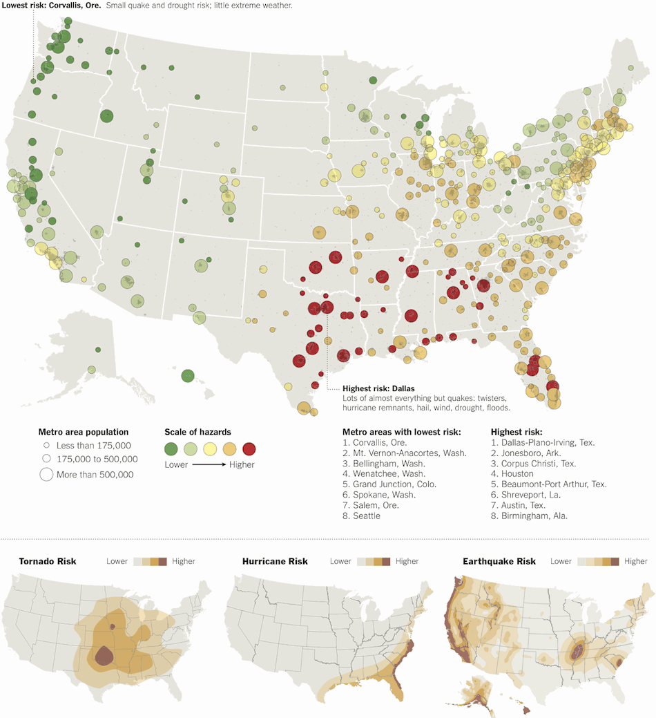
Extreme Weather (NYT)

Slide 19
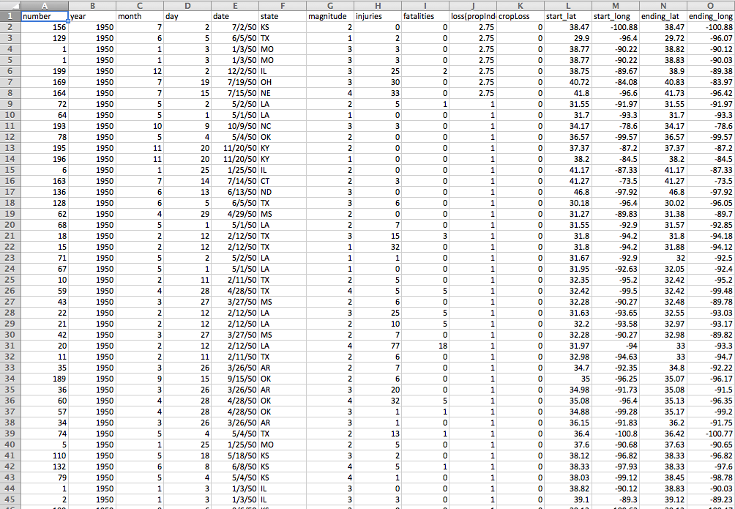
Tornado Data (NOAA)

Slide 20
Tornados in 1999 (by property damage $)

Slide 21
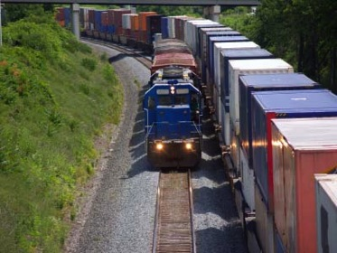
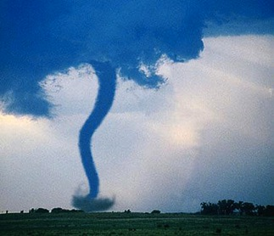
Truck & Rail Shipments + Tornados [time lapse: 1950-2010]
+

Slide 22
1950

Slide 82
2010

